Slide 1

Modifiers
.net / Microsoft dynamics 365

Slide 2
Modifiers are C# keywords used to modify declarations of types (class, struct, interface, enum) and type members (fields, properties, methods, indexers, etc).
http://diranieh.com/NETCSharp/Modifiers.htm
https://docs.microsoft.com/en-us/dotnet/csharp/language-reference/keywords/

Slide 3
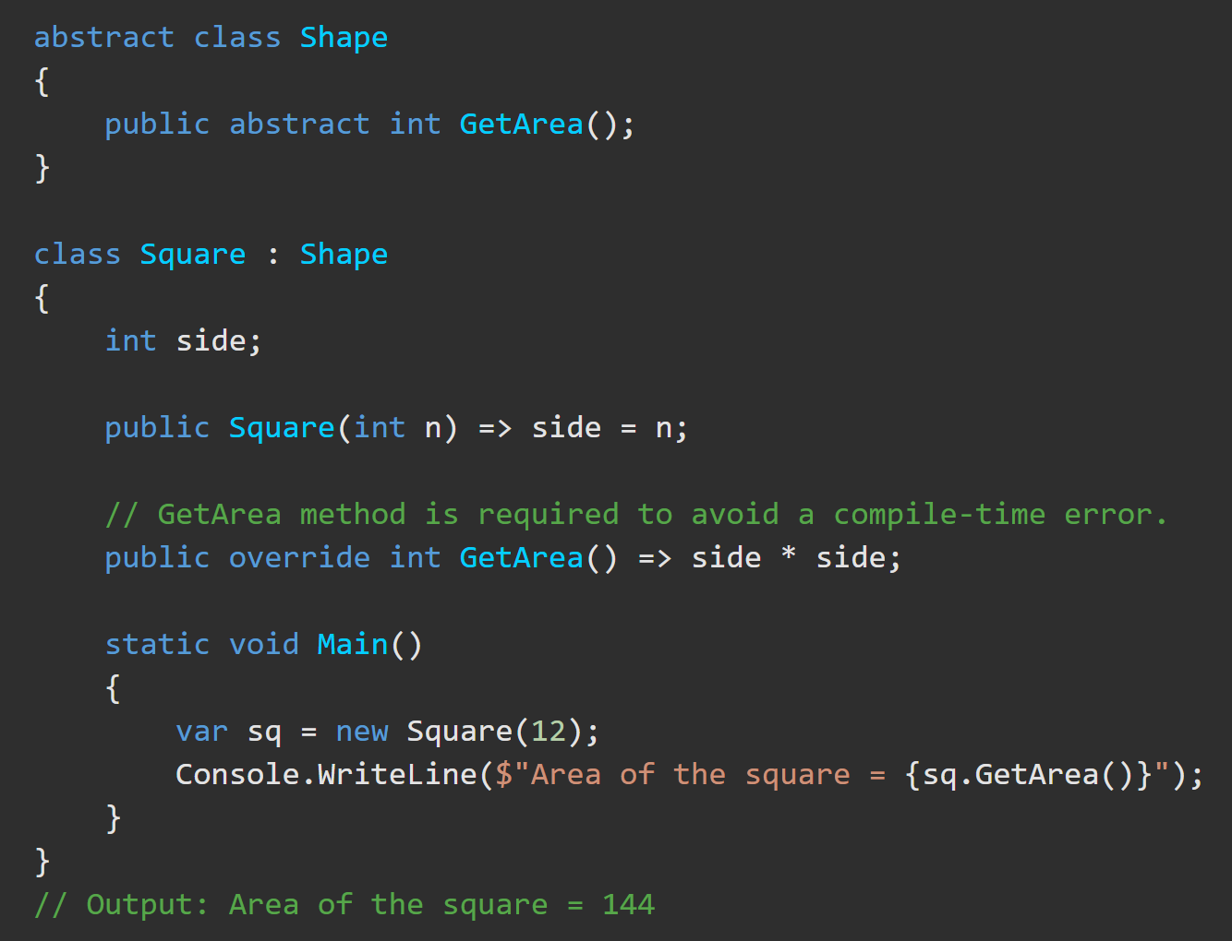
Modifiers – Abstract https://docs.microsoft.com/en-us/dotnet/csharp/language-reference/keywords/abstract
abstract means the thing being modified has a missing or incomplete implementation.
intended only to be a base class of other classes,
NOT instantiated on their own.
classes, methods, properties, indexers, and events can be abstract
Members marked as abstract must be implemented by non-abstract classes that derive from the abstract class.

Slide 4
Modifiers – Abstract https://docs.microsoft.com/en-us/dotnet/csharp/language-reference/keywords/abstract
Abstract CLASSES…
cannot be instantiated.
may contain abstract methods and accessors.
must provide implementation for all interface members.
Cannot include the sealed modifier.
Abstract METHODS…
An abstract method is implicitly a virtual method.
are only permitted in abstract classes.
do not have { } or method body
only have implementation in derived class methods using override.
Cannot have static or virtual modifiers
Abstract PROPERTIES…
It is an error to use the abstract modifier on a static property.
can be overridden in a derived class by including the override modifier.

Slide 5
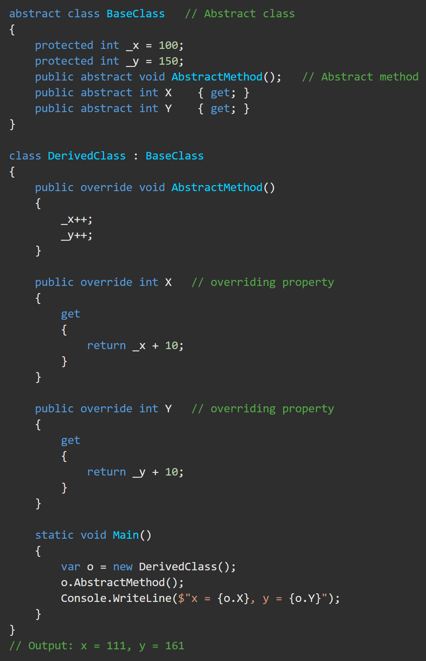
Modifiers – Abstract https://docs.microsoft.com/en-us/dotnet/csharp/language-reference/keywords/abstract
DerivedClass is derived from an abstract class BaseClass. The abstract class contains an abstract method, AbstractMethod, and two abstract properties, X and Y.
If you attempt to instantiate the abstract class by using a statement like this:
You will get an error saying that the compiler cannot create an instance of the abstract class 'BaseClass'.

Slide 6
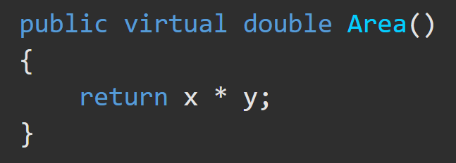
Modifiers – Virtual https://docs.microsoft.com/en-us/dotnet/csharp/language-reference/keywords/virtual
The virtual keyword is used to modify a method, property, indexer, or event declaration and allow for it to be overridden in a derived class.
The implementation of a virtual member can be changed by an overriding member in a derived class.

Slide 7
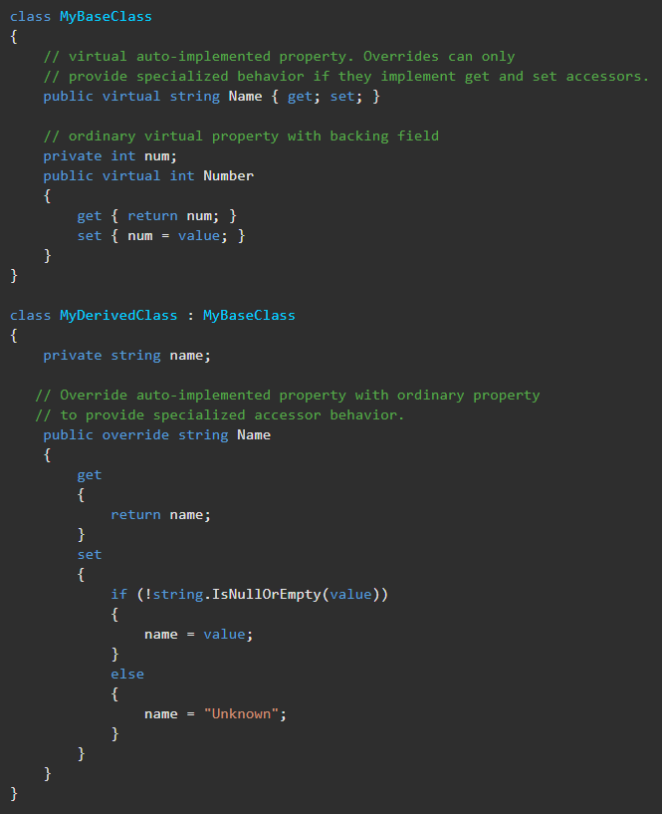
Modifiers – Virtual https://docs.microsoft.com/en-us/dotnet/csharp/language-reference/keywords/virtual
By default, methods are non-virtual. You cannot override a non-virtual method.
You cannot use the virtual modifier with the static, abstract, private, or override modifiers.
A virtual inherited property can be overridden by using the override modifier.

Slide 8
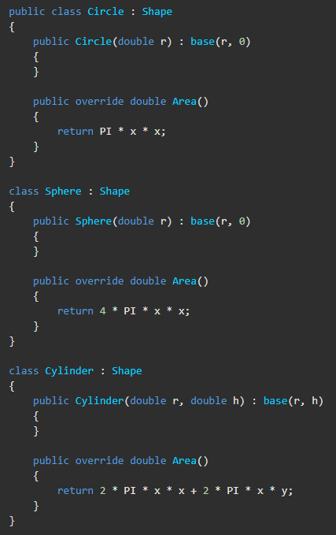
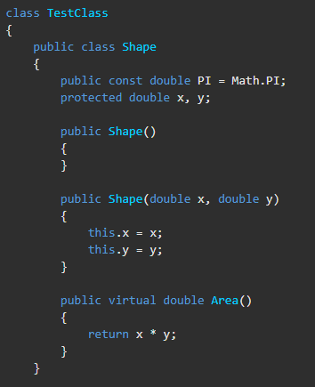
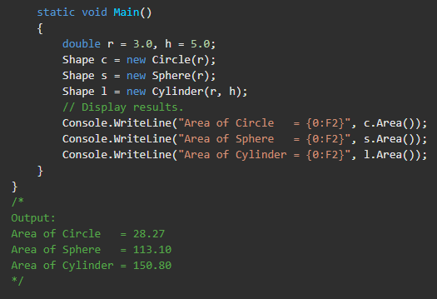
Modifiers – Virtual https://docs.microsoft.com/en-us/dotnet/csharp/language-reference/keywords/virtual
The Shape class contains the two coordinates x, y, and the Area() virtual method. Different shape classes such as Circle, Cylinder, and Sphere inherit the Shape class, and the surface area is calculated for each figure. Each derived class has its own override implementation of Area().

Slide 9
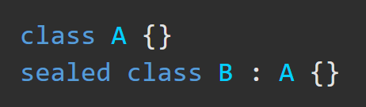
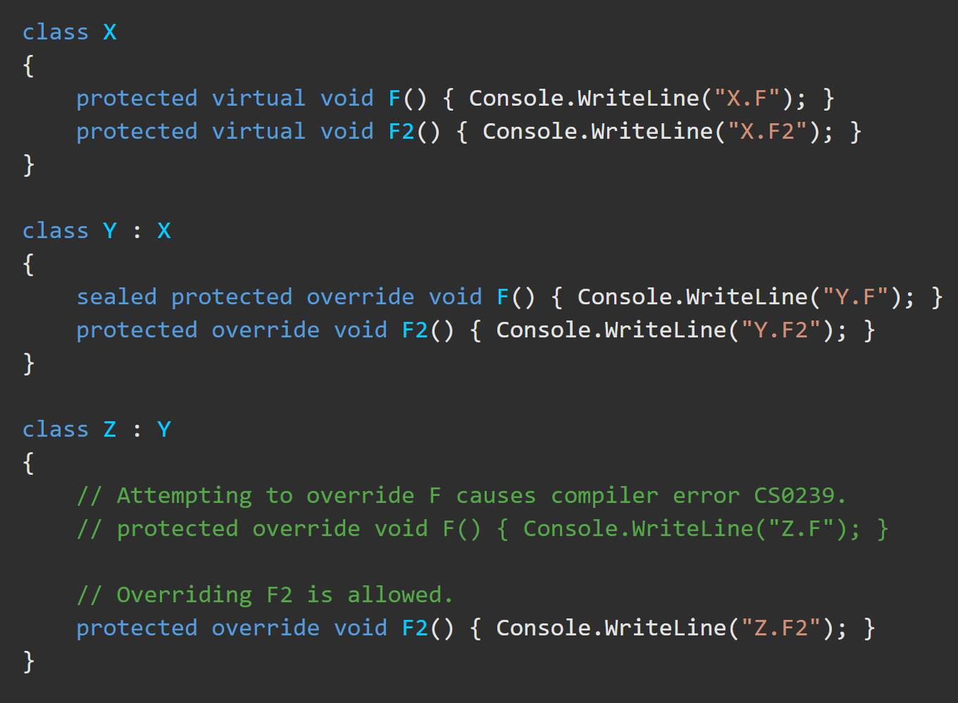
Modifiers – Sealed https://docs.microsoft.com/en-us/dotnet/csharp/language-reference/keywords/sealed
The sealed modifier prevents other classes from inheriting from it.
In this example, Z inherits from Y but Z cannot override the virtual function F that is declared in X and sealed in Y.

Slide 10


Modifiers – Sealed https://docs.microsoft.com/en-us/dotnet/csharp/language-reference/keywords/sealed
Modifiers – Sealed https://docs.microsoft.com/en-us/dotnet/csharp/language-reference/keywords/sealed
When should you use Sealed? Consider…
The potential benefits that deriving classes might gain through the ability to customize your class.
The potential that deriving classes could modify your classes in such a way that they would no longer work correctly or as expected.

Slide 11
Modifiers – Static https://docs.microsoft.com/en-us/dotnet/csharp/language-reference/keywords/static
Static CLASSES…
Members of a class share one copy of each static field.(Ex. To count total employees)
If a class is static, all It’s members must be static.
Static METHODS…
Cannot use this to reference static methods or property accessors.
Static PROPERTIES :
Belongs to the class type itself rather than the specific object instance.
A static member is referenced through the type name. (ex. Class.Struct.prop)

Slide 12
Modifiers – readonly https://docs.microsoft.com/en-us/dotnet/csharp/language-reference/keywords/readonly
readonly can only be used in four contexts.
The initialization can only occur as part of the declaration or in a constructor in the same class.
In a readonly struct definition. This makes the struct immutable.
In a readonly member definition, showing that it doesn’t change the struct's internal state.
In a ref readonly method return, the method returns a reference and its immutable.

Slide 13
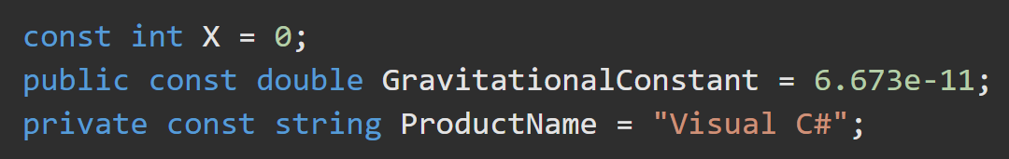
Modifiers – Const https://docs.microsoft.com/en-us/dotnet/csharp/language-reference/keywords/const
the only possible values for constants of reference types are string and a null reference.
Const fields and locals aren't variables and may not be modified.
Const fields can be numbers, Boolean values, strings, or a null reference.
The only reference types that can be const are string and a null reference.
The static modifier is not allowed in a const declaration.

Slide 14
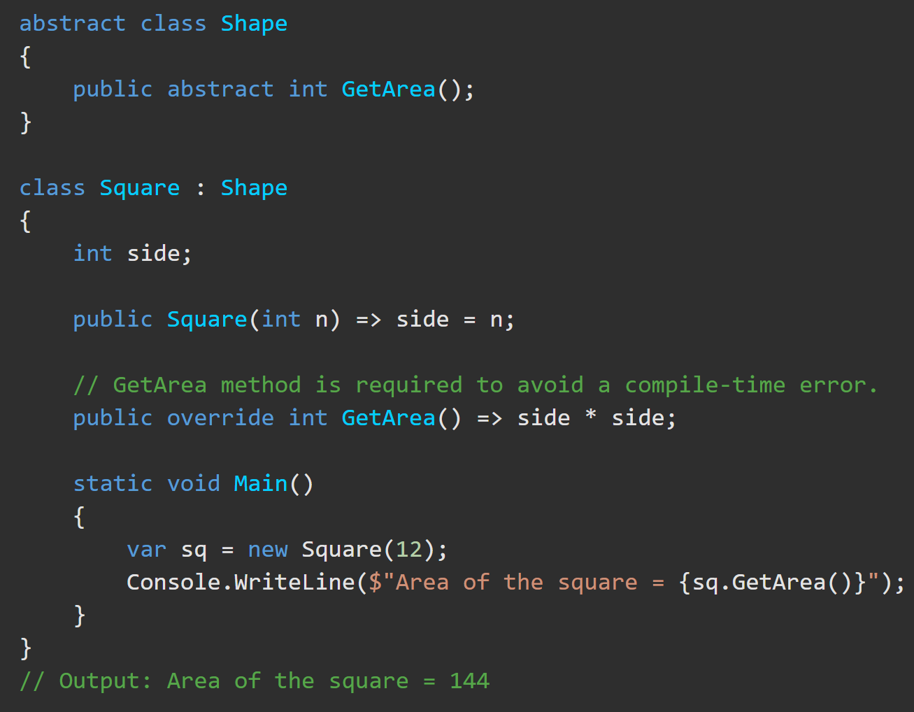
Modifiers – Override https://docs.microsoft.com/en-us/dotnet/csharp/language-reference/keywords/override
The override modifier is required to extend or modify the abstract or virtual implementation of an inherited method, property, indexer, or event.
Override Methods…
provides a new implementation of an inherited method
must have the same signature as the inherited method.
Both methods must be virtual, abstract, or override.
You cannot use the static, or virtual modifiers to modify an override method.
Override properties…
must have the same access modifier, type, and name as the inherited property.
can only override virtual, abstract, or override properties.

Slide 15
WiP below

Slide 16
Modifiers – Async https://docs.microsoft.com/en-us/dotnet/csharp/language-reference/keywords/async
Use the async modifier to specify that a method, lambda expression, or anonymous method is asynchronous. If you use this modifier on a method or expression, it's referred to as an async method.
An async method uses the await operator to do potentially long-running work without blocking the caller’s thread
An async method runs synchronously until it reaches its first await expression, at which point the method is suspended until the awaited task is complete. In the meantime, control returns to the caller of the method, as the example in the next section shows.
The async keyword is contextual in that it's a keyword only when it modifies a method, a lambda expression, or an anonymous method. In all other contexts, it's interpreted as an identifier.
The async method can't declare any in, ref or out parameters, nor can it have a reference return value, but it can call methods that have such parameters.

Slide 17
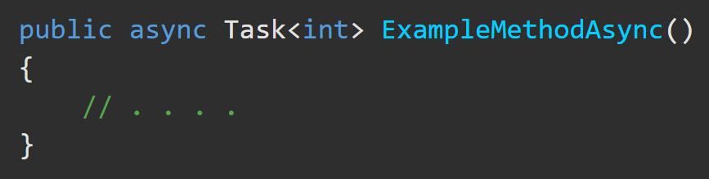
Modifiers – Async https://docs.microsoft.com/en-us/dotnet/csharp/language-reference/keywords/async
An async method can have only the following return types:
Task
Task<TResult>
void async void methods are generally discouraged.
The async method can't declare any in, ref or out parameters, nor can it have a reference return value, but it can call methods that have such parameters.

Slide 18
Modifiers – Async (in action) https://docs.microsoft.com/en-us/dotnet/csharp/programming-guide/concepts/async/
WiP

Slide 19
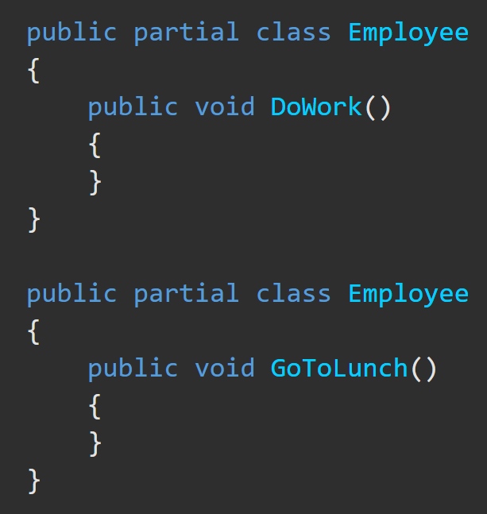
Partial Classes, Structs, Interfaces https://docs.microsoft.com/en-us/dotnet/csharp/programming-guide/classes-and-structs/partial-classes-and-methods
You can split the definition of a class, a struct, an interface or a method over two or more source files. Each source file contains a section. All parts are combined on compilation.
When would you do this?
To allow multiple programmers to work on the code at the same time.
When working with automatically generated source, code can be added to the class without having to recreate the source file. Visual Studio uses this approach when it creates Windows Forms, Web service wrapper code, and so on. You can create code that uses these classes without having to modify the file created by Visual Studio.
Use the partial keyword and same access modifier on all partial sections.
Attributes, inherited classes, etc, are merged at compile-time.
Each partial declaration must have the same parameter names in the same order.

Slide 20
Partial Methods https://docs.microsoft.com/en-us/dotnet/csharp/programming-guide/classes-and-structs/partial-classes-and-methods
A partial class or struct may contain a partial method. One part of the class contains the signature of the method.
Must begin with partial.
They are implicitly private and cannot be virtual or extern.
They can be generic.
An optional implementation may be defined in the same part or another part.
If the implementation is not supplied, then the method and all calls to the method are removed at compile time.
Partial methods enable the implementer of one part of a class to define a method, while another part implements it. No run-time errors result if a method is called but not implemented.
Partial methods are especially useful when customizing generated code. A method name and signature can be reserved, then generated code can call the method. The developer can decide whether to implement the method. Like partial classes, partial methods enable code created by a code generator and code created by a human developer to work together without run-time costs.

